Slide 1
Oh, the Places You’ll Go …and Eat!
Oh, the Places You’ll Go …and Eat!
Project-1 presented by Connie Pope, Alexis Rajis, Nam Truong

Slide 2
Are you a FOODIE who likes to travel and explore your taste buds?
Think of all the amazing cuisines you can experience at top restaurants in that area.
Let's explore together!

Slide 3
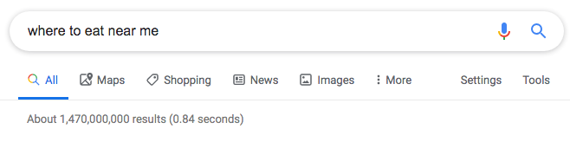
Problem:
Notes:
When people travel, they usually refer to the internet to find a place to eat.

Slide 4
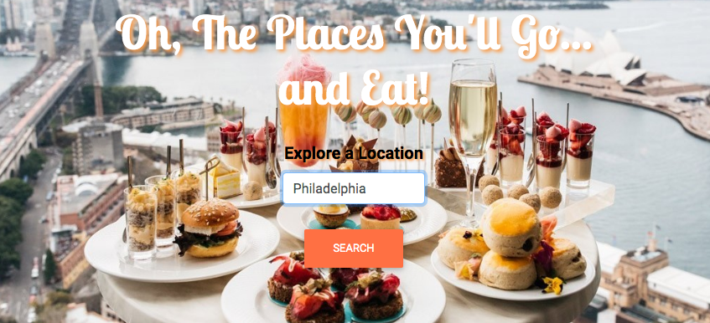
Solution:
Notes:
So we created a site that users can enter in their location…

Slide 5
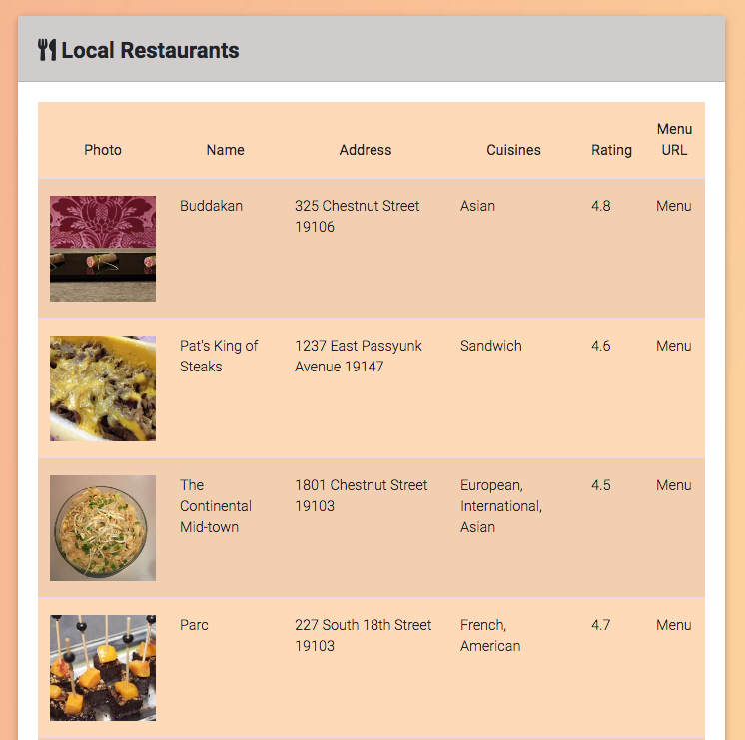
Solution:
Notes:
…and a list of restaurants nearby will display.
Including the name of the restaurant, the address, the type of cuisines they offer, a rating, a link to their menu and a photo.

Slide 6
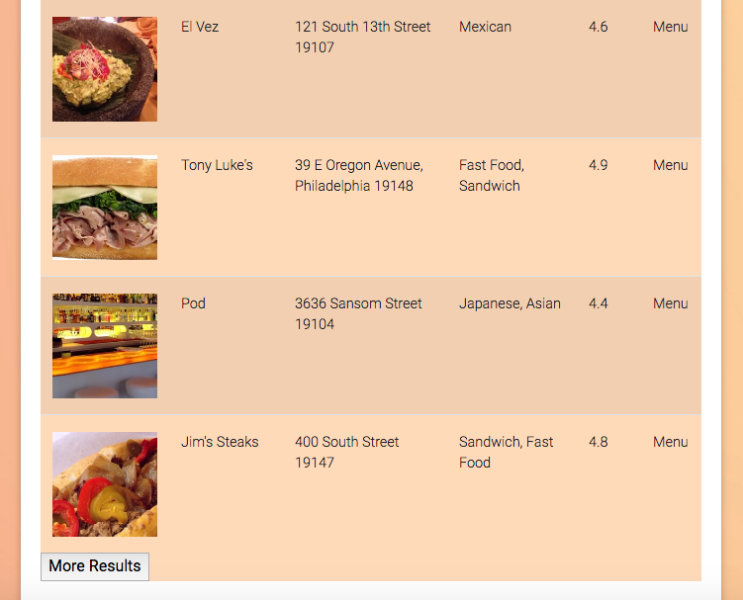
Solution:
Notes:
If the user would like more options, they can click on the More Results button and get 10 more restaurant options with each click.

Slide 7










Notes:
We used HTML, CSS, MDBootstrap, Javascript, jQuery, FirebaseDB, GoogleFonts, FontAwesome, AJAX, and APIs in our project.

Slide 8
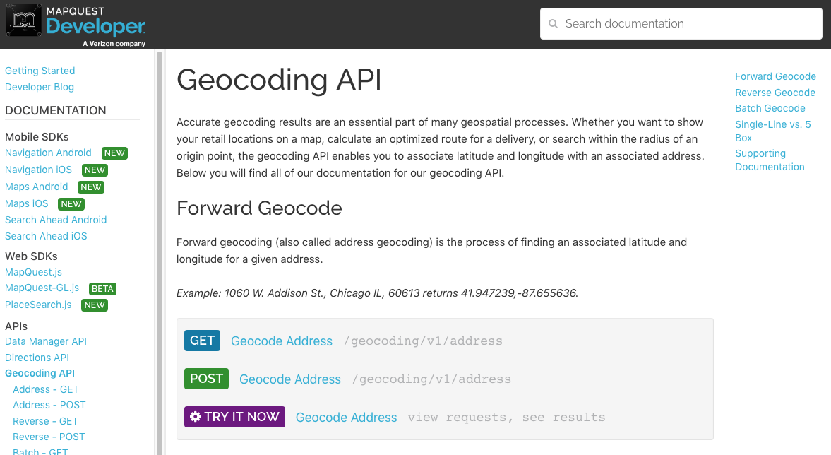
Mapquest Geocoder API
Notes:
We used the Mapquest Geocoder API to take the location and convert it to latitude and longitude. Which was necessary to get accurate results in the next API we used, which was…

Slide 9
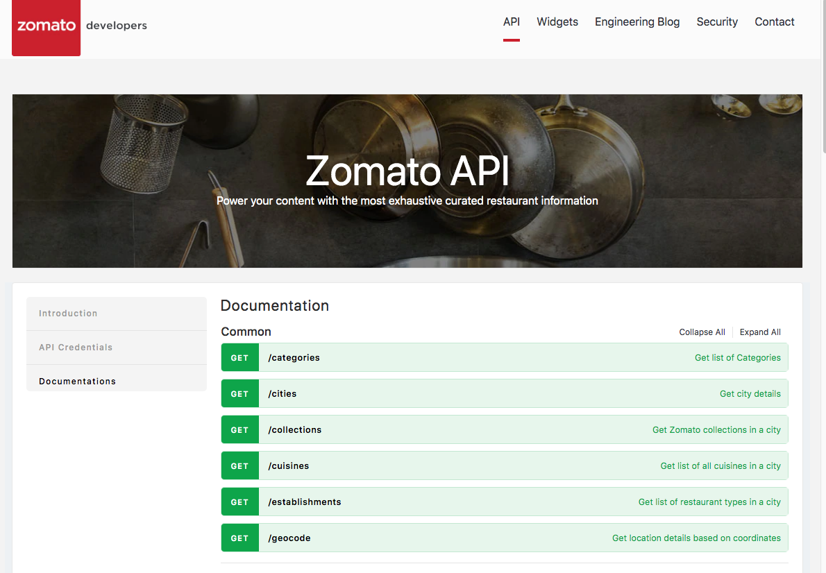
Zomato API
Notes:
… the Zomato API.
Zomato API takes in the latitude and longitude coordinates and lists restaurants that are nearby and the details about them.

Slide 10
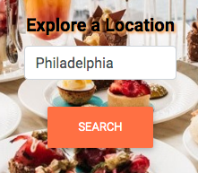
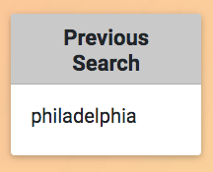
Firebase
Notes:
Firebase was used to store the input location and display as the Previous Search.

Slide 11
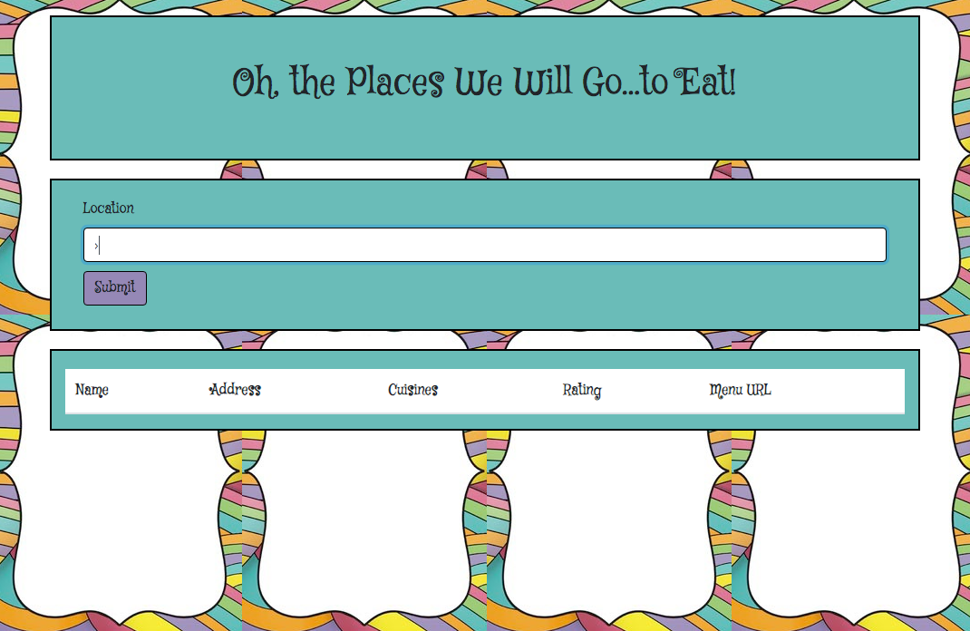
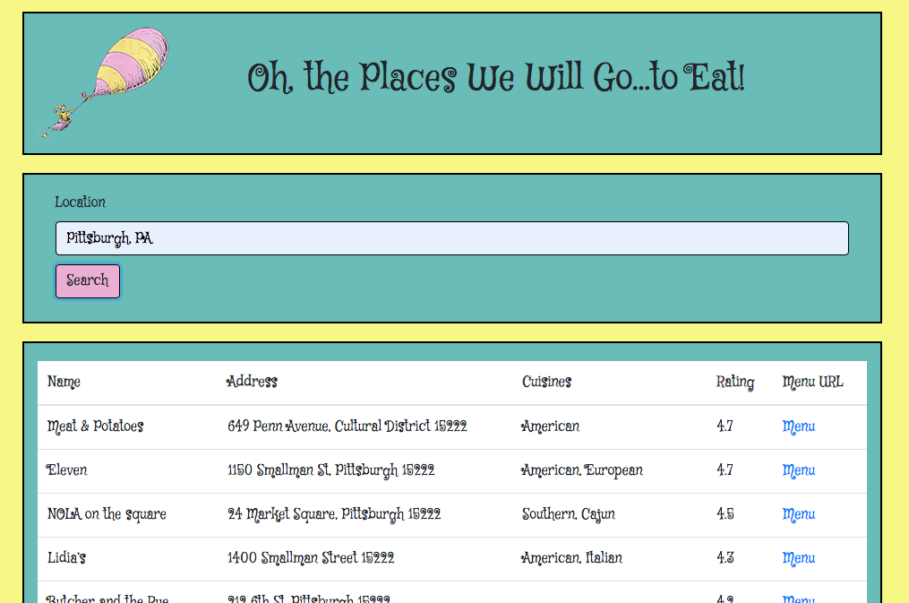
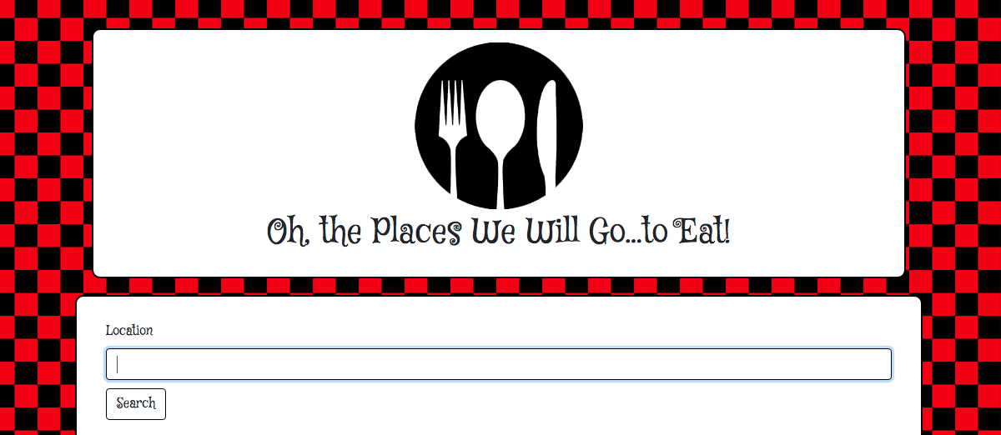
Design
Notes:
Our design started with a Dr. Seuss-like theme to go with the title. We weren’t crazy about the direction that was taking so we went with a more professional foodie theme.

Slide 12
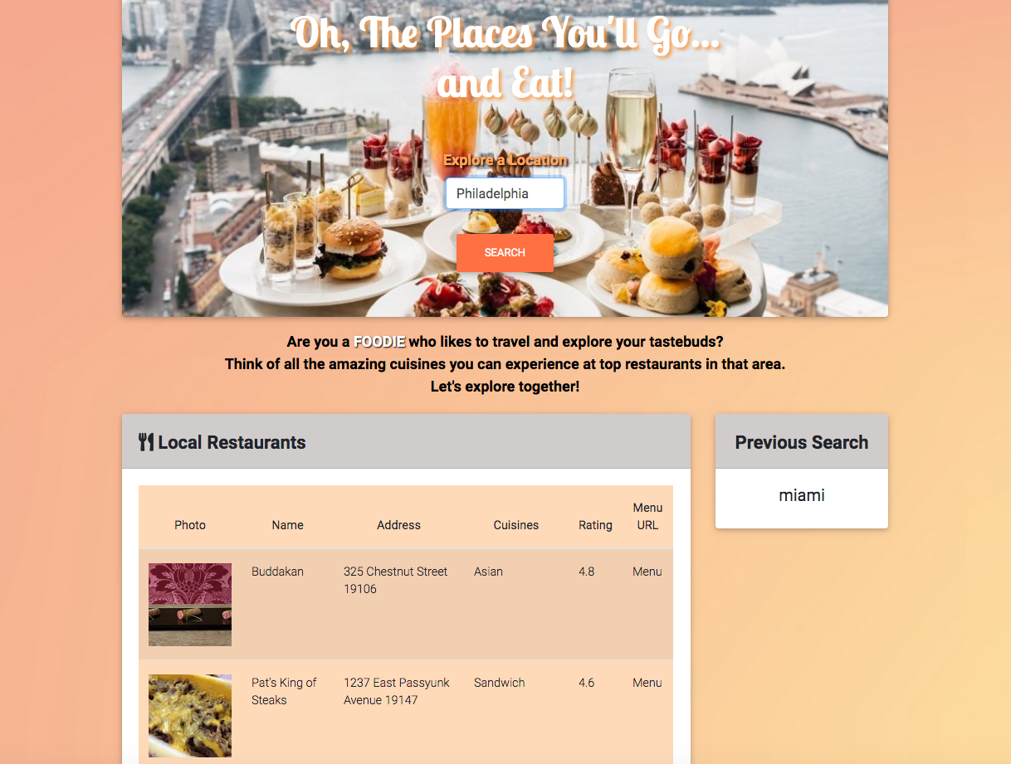
Notes:
And this is what we came up with. We used the CSS framework, MDBootstrap to help create the look of our website.

Slide 13
Connie’s contributions:
Came up with the title and travel theme
Worked on the Zomato and Mapquest APIs
Set up the AJAX results
Expanded on the results
General delegater of tasks.
Notes:
(Connie) I came up with the title and travel theme, worked on the Zomato and Mapquest APIs, set up the AJAX results, expanded on the results, and was the general delegater of tasks.

Slide 14
Alexis’s contributions:
Set up the Recent Search feature
Coded the callback from firebase to display on the webpage
Created the design and layout of the page
Added custom CSS.
Added restaurant photos to table.
Notes:
(Alexis) I set up the Recent Search feature, coded the callback from firebase to display on the webpage, created the design and layout of the page, added custom CSS and added restaurant photos to the table.

Slide 15
Nam’s contributions:
Created the HTML skeleton
Pulled the API info into the table
Went over debugging
Notes:
(Nam) I created the HTML skeleton, pulled the API info into the table, and went over debugging.

Slide 16

Project Management
Debugging
Collaboration
Collaboration
Problem Solving
Team Work
Github
Ideas
Notes:
We collaborated a lot with this project. Whenever debugging was necessary or when issues came up, approving different designs, and walking each other through github.

Slide 17
Challenges:
Forgetting ".length" in a ‘for’ loop
Figuring out why an API was not working
Getting the table to split into the correct columns
Making corrections to fix breaks
Creating a design that applied to the user demographics.
Solving merge conflicts in github
Notes:
Our challenges included forgetting ".length" in a for loop, figuring out why an API was not working, getting the table to split into the correct columns, making corrections to fix breaks, creating a design that applied to the user demographics, and solving merge conflicts in github.
Working together was good for us because we were able to help each other and we were on slack daily to communicate what was or was not working, what we were currently working on, and throwing ideas around. Luckily issues were minimal for us. I think we were all impressed by what we were able to accomplish.

Slide 18
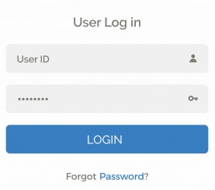
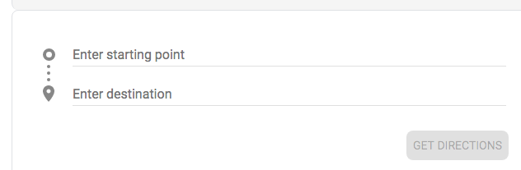


Future Features:
Adding directions to the restaurant from their selected location
Adding a favorites section
Adding a search by cuisine option
Incorporating a user login to save their personal searches.
Notes:
Some ideas we would like to incorporate in the future: adding directions to the restaurant from their selected location, adding a favorites section, adding a search by cuisine option, and incorporating a user login to save their personal searches.

Slide 19
Demonstration
Demonstration

Slide 20

Questions?

